Slide 1
Excellence Programs
Update for Branch Managers
July 2020

Slide 2
Content
Context and Background
Overview
Excellence Programs and Leadership Table
Commercial Benefits
Areas of focus
What you can do to help

Slide 3

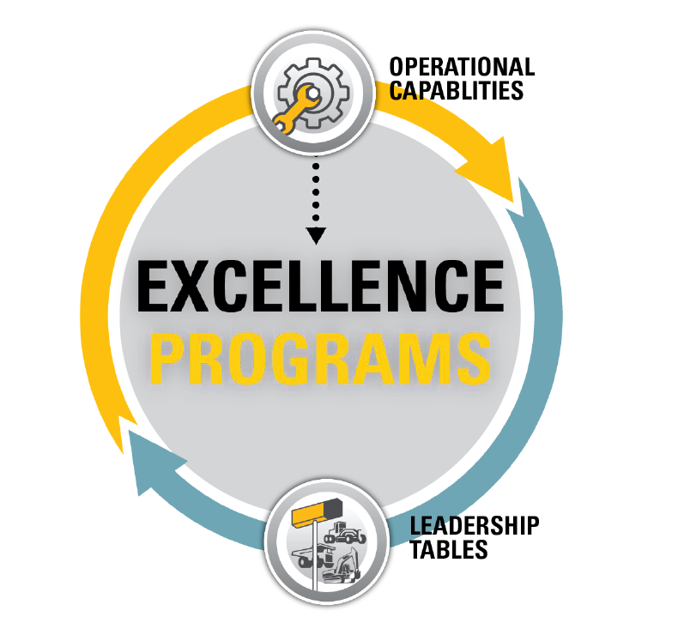
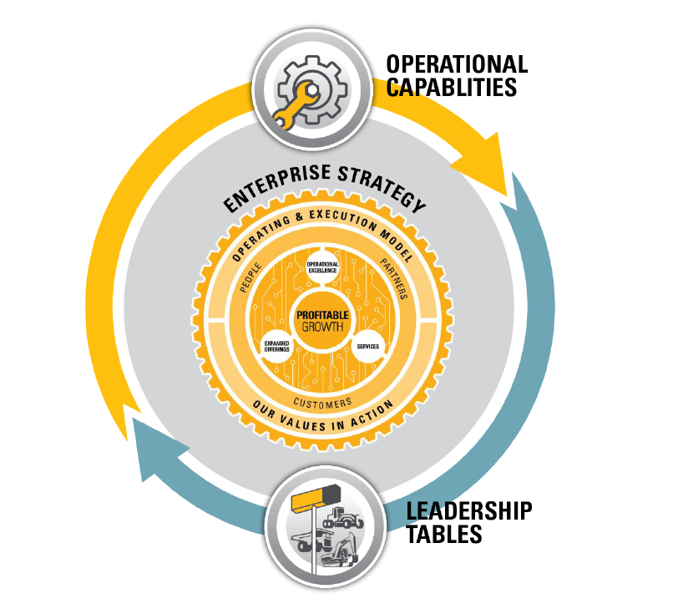
CONTEXT AND BACKGROUND
Terra Cat Business Strategy, Transition Plan, Leadership Table initiatives and Excellence Programs all have a ‘pull’ on organisational activity and capacity.
Governance at an ‘Enterprise’ level supports business alignment and initiative prioritisation.
Benefits of Excellence Programs – What’s in it for us!
Driving excellence and consistency in capabilities
Revealing a clear path for growth
Providing visibility into best practices
Recognising dealers for performance and commitment to excellence
Alignment to enterprise strategy for operational excellence

Slide 4
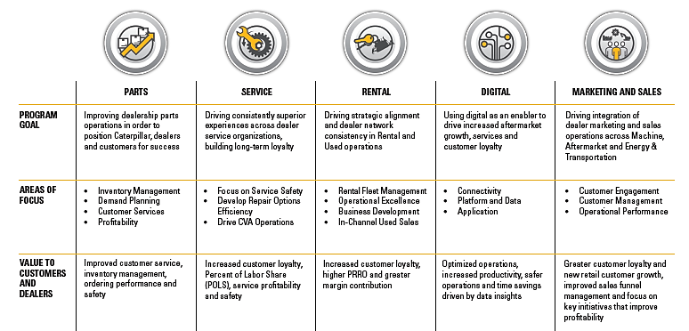

OVERVIEW
Caterpillar and Cat dealers must continually grow and evolve our capabilities to ensure that we remain leaders in our industries and our customers’ first choice.
The Excellence Programs allow us to deliver more customer value and produce profitable growth.

Slide 5
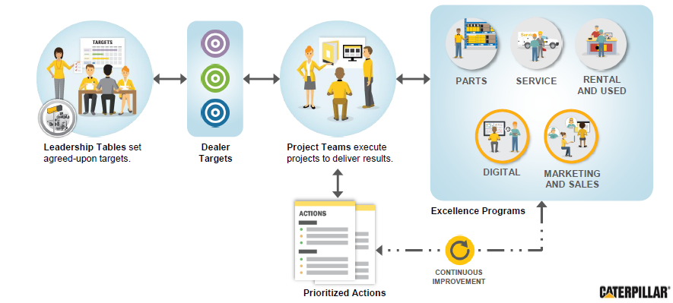
HOW EXCELLENCE PROGRAMS WORK
Excellence Programs contribute to Leadership Table business cases by identifying and closing gaps.

Slide 6
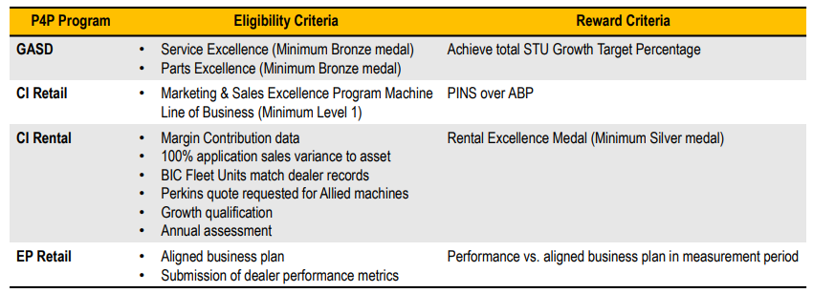
COMMERCIAL BENEFIT
Pay for Performance rewards Dealers through their Excellence Programs levels. The year-end medal is determined by taking the dealer’s medals for their two best performing quarters and then selecting the lower of these two medals.
We are on track to retain Bronze for Parts and achieve Bronze in Service and Digital for Q2.
Parts & Service Example:
Parts Excellence 2020 year-end medal: Silver
Service Excellence 2020 year-end medal: Silver
STU growth target: Achieved
% of 2020 orders payout: 1.00%
2020 DPO Actuals: $135M
Pay-For-Performance calculated payout:
1.00% * $135M
Award = $1,350M
Marketing & Sales Example:
Dealer A has a First Half, Retail GCI PINS goal of 30.0.
January – June Actual PINS is 32.3 on sales of $7,00,000.00 average dealer net.
Qualifying units represent $6,000,000.00 of sales.
Pay for Performance calculated payout:
($6,000,000.00 x 0.5% (>1.5 PINS) = $30,000).
Award = $30,000

Slide 7





MAPPING TO COMMERICAL DRIVERS
Category & Intent |  | Level | Focus Areas | Outcomes | Commercial Drivers
Digital |  |  | Strategic leadership Infrastructure Operational efficiency Digital commercialization Interfaces | Customer Loyalty Customer Experience Operational Efficiencies Value-Added Services | NLS eCommerce customers % online parts sales POCA % of connected assets Subscription activation rate
Marketing & Sales |  |  | Customer engagement Customer management Funnel management Strategic leadership | Customer Loyalty Customer growth Sales Funnel Velocity | Dealer revenue PINS (Retail / Rental) POPS New Customers CVA’s Leads / Quotes / Wins
Parts |  |  | Inventory management Parts warehousing Customer service (CX) Distribution | Safety Customer service Inventory Management Ordering performance | Order need by / planning OTIL Stock Turns / Returns Emergency value / preventable emergency
Rental |  |  | Rental fleet management Operational excellence Business development In-Channel used sales | Customer Loyalty Higher PRRO Margin Contribution | Financial utilisation, maintenance & repair RPO conversions ‘Return to Ready’ days Rental fleet sold with CVA CCU rental rollouts
 |  |  | Customer satisfaction (CX) Quality Efficiency and effectiveness Profitability in service operations | Safety Customer Loyalty % Labour Share (POLS) Service Profitability | POLS % Utilisation Productivity Technician skills WIP
Service

Slide 8
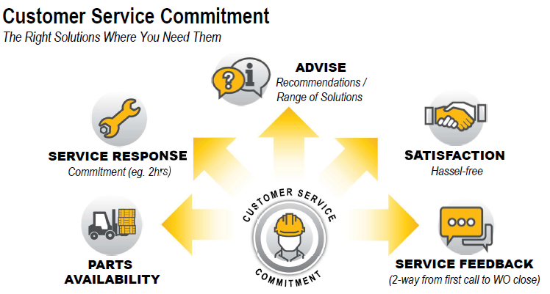
What you can do to help
Call to action – the top 8 things you can do to make a difference
Increase personal awareness of all 5 Excellence Programs and what they mean
Follow best practice at all times (consistency is the key)
Get the know the ‘levers’ to pull to make a difference
Lead times for parts
Returns
Emergency value
Standard job variance
Put the Customer Experience training into practice (NLS)
Focus on ‘right first time’ (rework)
Ensure all technicians have development plans (TCDP)
Understand and have ability to ‘sell the value’ of connectivity / digital
Influence, coach and support others

